Slide 1
ACTIVE CITIZENS, STRONGER COMMUNITIES How Local Governments Can Support Citizenship for Eligible Lawful Permanent Residents in California
October 17, 2013
Notes:
My name is Mahvash Hassan and I am a public engagement consultant from the Institute for Local Government. I have spent the last year collaborating with cities, counties, community-based organizations as well as regional and national colleges and universities to develop citizenship resources to support local officials across California and I am very excited to share it with you today. We will be referencing numerous resources on the webinar today and will be sure to provide links as we go, at the end of the webinar as well as a follow-up. In addition to presentations we will be polling you to better understand your familiarity with the Citizenship and Naturalization needs of lawful permanent residents in your community. Please feel free to type in questions in the question box on the right side of your screen at any time during this webinar.

Slide 2
Goals for Today’s Webinar:
Learn how and why local governments support and encourage lawful permanent residents become United States’ citizens
Share tips on engaging lawful permanent residents and newly naturalized citizens in your community
Understand the role of partnerships between local governments, federal agencies and community-based organizations to support citizenship efforts

Slide 3
Agenda
Introduction
Mahvash Hassan, Institute for Local Government
Local Governments and Citizenship
Sara Campos, Attorney, Author and Consultant
Citizenship – Process, Hurdles and Resources
Eric Cohen, Executive Director, Immigrant Legal Resource Center
Santa Clara County Citizenship Collaborative
Teresa Castellanos, Program Coordinator, Immigrant Relations and Integration Services (IRIS), Office of Human Relations, County of Santa Clara
Your Experience, Questions and Ways to Learn More
Notes:
Sara Campos is an author, attorney and consultant to ILG on the Citizenship Project. She has served as a Staff Attorney for the National Immigration Law Center and the Lawyers Committee for Civil Rights of the San Francisco Bay Area. She is also a professor of Refugee Law and has taught at Golden Gate University and University of San Francisco Law Schools.
Eric Cohen, executive director of the Immigrant Legal Resource Center is a national expert on naturalization and citizenship law. He also heads up the New Americans Campaign a national network of legal-service organizations, faith-based organizations, businesses, foundations and community leaders that is paving a better road to citizenship.
Ms. Castellanos has a 25 year history of working on immigration concerns through government, labor and community based organizations such as Justice for Janitors, the Health Workers Union, and Catholic Charities.
Teresa has been on the forefront of several projects including the coordination of an annual citizenship day event in 14 languages, bimonthly forums, and an immigrant leadership course. She oversees immigrant community education projects, an interactive website: www.immigrantinfo.org., the Immigrant speaker’s bureau, and the Immigrant Survivors of Domestic Violence Committee. In 1999 she staffed the project that conducted research of immigrant communities in Santa Clara County, CA. She contributed to Bridging Borders in Silicon Valley and KIN: Knowledge of Immigrant Nationalities, two books based on the data from the Summit on Immigrant Needs and Contributions.

Slide 4
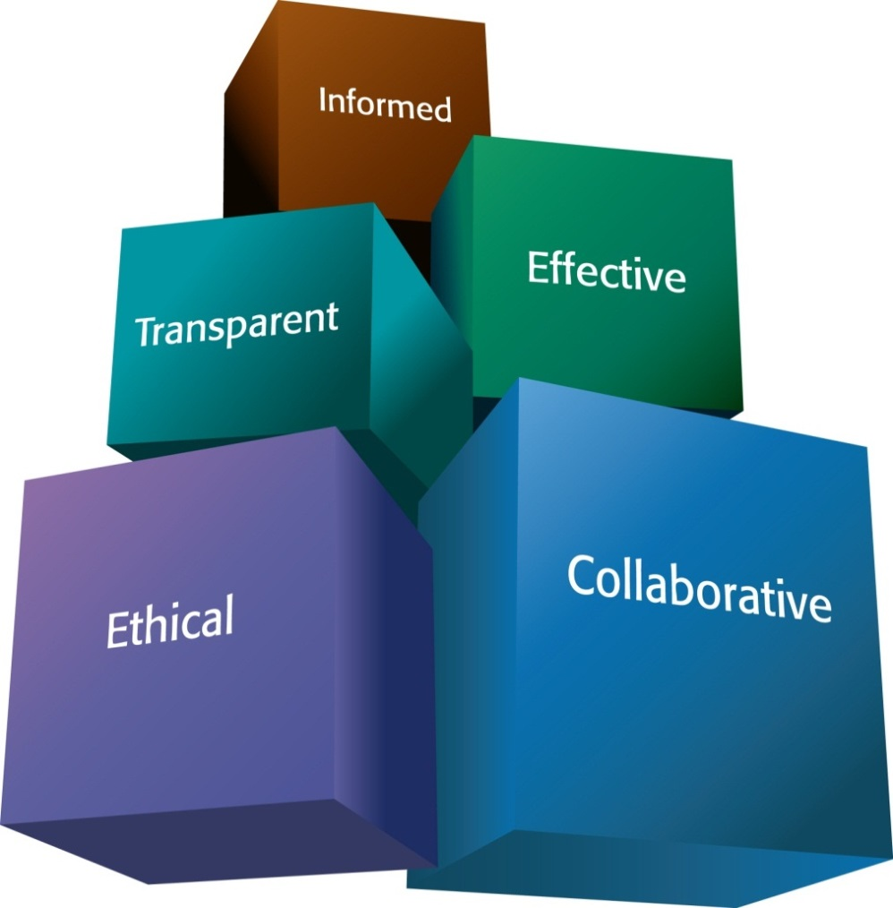
ILG Mission
Promoting good government at the local level
Practical, impartial and easy-to-use materials
Notes:
) The Institute for Local Government is the non-profit research and education affiliate of the League of California Cities and the California State Association of Counties. Our mission is to promote good government at the local level and provide practical, impartial and easy-to-use resources that can help local elected officials and staff in their work.

Slide 5
Resources for Local Officials
Sustainability, Public Service Ethics, Local Government 101 and
Effective and Inclusive Public Engagement and Immigrant Integration
Notes:
ILG develops resources in many areas including public service ethics ,sustainable communities and public engagement
I am part of the Public Engagement program at ILG where we work in particular effective and inclusive public engagement.

Slide 6
ILG’s Inclusive Engagement and Immigrant Integration Work
How can our resources support the local officials’ desire to broaden participation in their public engagement efforts?
How can local governments create, join and sustain multi-sector partnerships to build stronger communities?
Notes:
ILG’s Inclusive engagement and immigrant integration work is guided by the following questions

Slide 7
Why Citizenship?
California is home to 2.5 million lawful permanent residents eligible to naturalize and become US Citizens
Citizenship is a critical point along a
continuum of civic engagement
Notes:
There

Slide 8
Methodology
Survey of local officials – city and county
Survey of community- based organizations
Follow-up Interviews
Literature Survey

Slide 9
Methodology Continued…
Data
Migration Policy Institute
California Civic Engagement Project at UC Davis
Center for the Study of Immigrant Integration, USC
Peer Review

Slide 10
ILG’s Citizenship Resources for Local Officials
A Briefing Paper: Active Citizens, Stronger Communities: Helping Lawful Permanent Residents Become Citizens
Website Resources include:
Best Practices and Publications
USCIS Resources for Local Governments
County level data on foreign-born
Economic Impact of Naturalization
Stories from California and beyond
Notes:
Sara Campos will be sharing some of the key findings from this research and these are some of the resources available on ILG’s website.

Slide 11
Webinar Presenters
Sara Campos, Consultant saracampos@comcast.net
Eric Cohen, Immigrant Legal Resource Center, ecohen@ilrc.org
Teresa Castellanos, IRIS: Immigrant Relations& Integration Services Office of Human Relations Santa Clara County, Teresa.Castellanos@ohr.sccgov.org
Moderator, Mahvash Hassan, Institute for Local Government, mhassan@ca-ilg.org
Notes:
Sara Campos is an author, attorney and consultant to ILG on the Citizenship Project. She has served as a Staff Attorney for the National Immigration Law Center and the Lawyers Committee for Civil Rights of the San Francisco Bay Area. She is also a professor of Refugee Law and has taught at Golden Gate University and University of San Francisco Law Schools.
Eric Cohen, executive director of the Immigrant Legal Resource Center is a national expert on naturalization and citizenship law. He also heads up the New Americans Campaign a national network of legal-service organizations, faith-based organizations, businesses, foundations and community leaders that is paving a better road to citizenship.
Ms. Castellanos has a 25 year history of working on immigration concerns through government, labor and community based organizations such as Justice for Janitors, the Health Workers Union, and Catholic Charities.
Teresa has been on the forefront of several projects including the coordination of an annual citizenship day event in 14 languages, bimonthly forums, and an immigrant leadership course. She oversees immigrant community education projects, an interactive website: www.immigrantinfo.org., the Immigrant speaker’s bureau, and the Immigrant Survivors of Domestic Violence Committee. In 1999 she staffed the project that conducted research of immigrant communities in Santa Clara County, CA. She contributed to Bridging Borders in Silicon Valley and KIN: Knowledge of Immigrant Nationalities, two books based on the data from the Summit on Immigrant Needs and Contributions.

Slide 12
Helping Lawful Permanent Residents Become Citizens: Options for California Local Officials
Why become involved in naturalizing lawful
permanent residents in your communities?
Because your community stands to benefit.

Slide 13
How does encouraging immigrants to naturalize benefit your community?
Increasing naturalization in your community
can lead to:
Greater civic participation
Greater social cohesion
Increased economic growth

Slide 14
About Lawful Permanent Residents
Lawful permanent residents may:
live permanently in the U.S.
own property
attend public schools, colleges
join some branches of the armed forces
travel freely within and outside the United States
maintain their status indefinitely

Slide 15
About Lawful Permanent Residents
But, lawful permanent residents:
Cannot vote
Cannot sit on juries
Cannot participate in some of the most important decisions of the communities where they live.

Slide 16
Why Naturalize?
Once lawful permanent residents become citizens they can:
Vote
Participate in the jury system
Run for political office
Compete for civil service jobs
Sense of belonging
Notes:
Last bullet: cite Sumption and Sarah Flamm, “The Economic Value of Citizenship for Immigrants in the United States,” Migration Policy Institute (2012)

Slide 17
Naturalization and Civic Participation
Desire for Stronger Community Ties
⬇
Naturalization
⬇
Higher level of involvement in community affairs
⬇
Greater Social Cohesion
Notes:
Alice Cottingham, Daranee Petson, Ted Wang, and Robert C. Winn, Building Capacity for ESL, Legal Services and Citizenship: A Guide for Philanthropic Investment and Partnerships. Grantmakers Concerned with Immigrants and Refugees. (2008)
Current population Survey Analysis, California Civic Engagement Project, Center for Regional Change, University of California, Davis (November 2010).

Slide 18
Data on Naturalization and Civic Participation
Compared with noncitizens, naturalized
citizens report higher levels of civic behavior
join groups
contact public officials
become civically involved

Slide 19
Economic Benefits of Naturalization
For legal immigrants who naturalize
8 to 11 percent greater income
15 percent increase in spending power
apply for federal civil service jobs/other positions requiring security clearance
Signal a greater sense of stability to
employers

Slide 20
Economic Benefits of Naturalization
Increasing the number of immigrants who naturalize can be a boon to individuals,
families and communities
Immigrant spending ➔ stimulates demand
for more products and services ➔ creates
jobs ➔ expand economy.

Slide 21
Getting Informed – The First Steps to Helping Immigrants Naturalize
Learn about immigrants in your community
Who are the immigrants in your community?
What are their nationalities and where are they from?
What language(s) do they speak?

Slide 22
Getting Informed – The First Steps to Helping Immigrants Naturalize
Find out about immigrant eligibility for naturalization
Are there many lawful permanent residents in your area?
Do these immigrants want to naturalize?
What barriers, if any, do they face?

Slide 23
Getting Informed – The First Steps to Helping Immigrants Naturalize
Do immigrants in your community have access to legal services?
Are high quality, low-cost legal services available in your community?
Are these services readily available or are there backlogs?
Are immigrants aware of these services and are they using them?

Slide 24
How and where to collect this information?
Go where immigrants congregate
Seek help from trusted community leaders, networks and community organizations known and trusted by immigrants
Engage public schools, adult education programs, colleges, universities and congregations in assessing the needs of immigrants in your community

Slide 25
How and where to collect this information? Continued…
Form an immigrant advisory committee or task force
Recruit other interested officials and community leaders to join you in your efforts
If you sponsor an event and invite immigrants, consider accessible and familiar locations.

Slide 26
Sources to learn about legal services in your area
Directory of free/low-cost legal service organizations
www.immigrationadvocates.org/nonprofit/legaldirectory

Slide 27
Resources for your Spanish-speaking community members
Citizenship Centers that provide a variety of citizenship services such as help with the naturalization application
www.ciudadania.yaeshora.info
Hotline operated by the National Association of Latino Elected Officials (NALEO) www.naleo.org

Slide 28
What if no legal services exist in your area?
Work with community services organizations to recruit lawyers and other volunteers interested in naturalizing immigrants.
BUT be aware of and educate immigrants in your community about fraudulent practitioners or so-called “notarios” in your community.

Slide 29
How Can Local Officials Help Immigrants Become Naturalized Citizens?
Host a citizenship day or drive
Orientation on naturalization with US Citizenship and Immigration Services (USCIS)
Nonprofit community organizations could speak to potential applicants about the naturalization process
Local Example –Through the “You,Me,We=Oakley!” Program, the city of Oakley has sponsored citizenship drives.

Slide 30
How Can Local Officials Help Immigrants Become Naturalized Citizens?
Offer to speak at a naturalization workshop
Examples: Local officials from the cities of Concord, Patterson, Riverbank, and Woodland spoke to potential applicants.

Slide 31
How Can Local Officials Help Immigrants Become Naturalized Citizens?
3. Provide space for citizenship classes
Community centers and other public agency facilities
Offer sites at off-peak hours
Offering such space signals to immigrants that they are welcome

Slide 32
How Can Local Officials Help Immigrants Become Naturalized Citizens?
4. Offer free citizenship classes
Riverside County Library
Cupertino Department of Parks and Recreation
Adult school in Ukiah
Santa Clara County

Slide 33
How Can Local Officials Help Immigrants Become Naturalized Citizens?
Partner with philanthropies and community-based organizations
3 year naturalization collaborative
$1.2M Budget – ½ from City, leveraging additional money from five local foundations along with technical assistance from Grantmakers Concerned with Immigrants and Refugees (GCIR) and the Immigrant Legal Resource Center (ILRC)
7 community-based organizations provide series of free legal and citizenship application workshops and language assistance to eligible immigrants.
Notes:
Example: City and County of San Francisco

Slide 34
How Can Local Officials Help Immigrants Become Naturalized Citizens?
Partner with U.S. Citizenship and Immigration Services
LAPL – 73 libraries
Designates citizenship corners
Hold citizenship workshops
Provide referrals
Provide materials in Spanish, Korean, Chinese, Vietnamese, Farsi, Russian and Japanese
Help members of the community better understand naturalization
Notes:
Examples: Los Angeles and San Diego Libraries

Slide 35
How Can Local Officials Help Immigrants Become Naturalized Citizens?
Apply for federal mini-grants
Cities and Counties eligible
Since the creation of these grants, the U.S. Citizenship and Immigration Services awarded $23.2 million through 142 grants to immigrant-serving organizations, including schools, libraries, and cities

Slide 36
How Can Local Officials Help Immigrants Become Naturalized Citizens?
Distribute information on naturalization efforts and technology
Use the ethnic media to inform immigrant communities of your efforts
Citizenshipworks.org

Slide 37
How Can Local Officials Help Immigrants Become Naturalized Citizens?
Citizenship Works - an interactive software that provides:
Free, step-by-step naturalization information
Naturalization forms
Self-paced tutorial that explained the process
Links to other resources and information about citizenship available online

Slide 38
How Can Local Officials Help Post-Naturalization
Attend/Speak at a naturalization ceremony
Underscore the importance of citizenship
Help deepen new citizens’ involvement in community affairs
Signal to immigrant community that they are welcome
Examples: The Vice-Mayor of Campbell and the Mayor of Redwood City welcomed new citizens last year.

Slide 39
How Can Local Officials Help Post-Naturalization
2. Host a Naturalization Ceremony
Consider offering space at municipal sites during times when they are not regularly used
July 4th, Constitution Day and Citizenship Day - high profile opportunities for local governments to recognize new citizens

Slide 40
How Can Local Officials Help Post-Naturalization
Help New Citizens Register to Vote
“Proud to be an American Citizenship Day” Local officials in Monterey and Santa Cruz county partner with the U.S. Citizenship and Immigration Services and a local congressional office
Register new citizens to vote and provide election information

Slide 41
How Can Local Officials Help Post-Naturalization
Work with the ethnic media to inform new immigrants on voter registration and voting
Partnership between Contra Costa, Santa Cruz, San Francisco, and Los Angeles county officials and local Univision Spanish-language stations:
to host voter registration sessions
provide information phone banks
and answer questions about registration and voting

Slide 42
How Can Local Officials Help Post-Naturalization
Partnership Radio Bilingue, aired voter education forums throughout California
You can reach out to television and radio affiliates in your area to organize similar programs.

Slide 43
Encouraging immigrants to participate in government life:
Integrating immigrants into the civic life of a community is a two-way process
Both newcomers and the neighborhood or town that receives them must work together to build stronger communities
Ensuring that newcomers are engaged both economically and civically builds communities with a stronger civic culture and increased policy effectiveness
Such communities become vibrant places to live and are more attractive to people and investors alike.

Slide 44
ILG’s Citizenship Resources
www.ca-ilg.org/immigrant-citizenship
www.ca-ilg.org/engaging-immigrants-and-new-citizens
Notes:
Active Citizens, Stronger Communities: Helping Lawful Permanent Residents Become Citizens Options for California Local Officials and other resources

